Slide 1
Introduction to PHP
PHP -- Personal Home Page

Slide 2
PHP
PHP Hypertext Preprocessor (Personal Home Page) (P-H-P) PHP started out as a wrapper around the Perl language.
At that time PHP stood for Personal Home Page. Today the acronym really does not stand for anything specific.

Slide 3
PHP Features
Basically, PHP is a server-side scripting language for HTML.
Scripting Language: A high level programming language that is interpreted by other programs at run time rather than compiled by computers processor as other programming languages are.

Slide 4
Server-side Programming :
It is the program that runs on server dealing with the generation of content of web page. 1) Querying the database 2) Operations over databases 3) Access/Write a file on server. 4) Interact with other servers. 5) Structure web applications. 6) Process user input. For example if user input is a text in search box, run a search algorithm on data stored on server and send the results.
Examples : The Programming languages for server-side programming are : 1) PHP 2) C++ 3) Java and JSP 4) Python 5) Ruby on Rails

Slide 5
Client-side Programming :
It is the program that runs on the client machine (browser) and deals with the user interface/display and any other processing that can happen on client machine like reading/writing cookies.
1) Interact with temporary storage 2) Make interactive web pages 3) Interact with local storage 4) Sending request for data to server 5) Send request to server 6) work as an interface between server and user
The Programming languages for client-side programming are : 1) Javascript 2) VBScript 3) HTML 4) CSS 5) AJAX

Slide 6
PHP Features
It can be used to add dynamic features to HTML pages or use it to create entire dynamic sites that generate HTML on the fly in response to user input.
Its syntax is a combination of C, Java, and Perl.

Slide 7
PHP Features
PHP is freely available and used primarily on Linux (UNIX) Web servers, and as an alternative to Microsoft's Active Server Pages (ASP) technology.
As with ASP, the PHP script is embedded within a Web page along with its HTML.

Slide 8
PHP Features
Before the page resolves, the Web server calls PHP to interpret and perform the operations called for in the PHP script.
An HTML page with PHP script is typically given a file name suffix of ".php," ".php4," or ".phtml."

Slide 9
PHP Features
In an HTML document, PHP script is enclosed within special PHP tags.
Because PHP is embedded within tags, the author can jump between HTML and PHP instead of having to rely on heavy amounts of code to output HTML.

Slide 10
PHP Features
PHP can perform any task, but its strength lies in its compatibility with many types of databases.
PHP can talk across networks

Slide 11
PHP Features
PHP was created sometime in 1994 by Rasmus Lerdorf.

Slide 12
Introduction to PHP
A PHP file may contain text, HTML tags and scripts.
Scripts in a PHP file are executed on the server.

Slide 13
Review
PHP stands for Hypertext Preprocessor
PHP is a server-side scripting language, like ASP
PHP scripts are executed on the server
PHP supports many databases (MySQL, Informix, Oracle, Sybase, Solid, PostgreSQL, Generic ODBC, etc.)
PHP is an open source software (OSS)
PHP is free to download and use

Slide 14
PHP File
PHP files may contain text, HTML tags and scripts
PHP files are returned to the browser as plain HTML
PHP files have a file extension of ".php", ".php4", or ".phtml"

Slide 15
Why PHP?
PHP runs on different platforms (Windows, Linux, Unix, etc.)
PHP is compatible with almost all servers used today (Apache, IIS, etc.)
PHP is FREE to download from the official PHP resource: www.php.net
PHP is easy to learn and runs efficiently on the server side

Slide 16
PHP Installation
Install an Apache server on a Windows or Linux machine
Install PHP on a Windows or Linux machine
Install MySQL on a Windows or Linux machine

Slide 17
Basic PHP Syntax
A PHP file normally contains HTML tags, just like an HTML file, and some PHP scripting code.

Slide 18
A Look
A Simple PHP script which sends the text "Hello World" to the browser:
<html>
<body>
<?php
echo "Hello World";
?>
</body>
</html>

Slide 19
Ctd..
A PHP scripting block always starts with <?php and ends with ?>.
A PHP scripting block can be placed anywhere in the document.
Each code line in PHP must end with a semicolon.
The semicolon is a separator and is used to distinguish one set of instructions from another.

Slide 20
Ctd..
There are two basic statements to output text with PHP:
echo and print.

Slide 21
Variables in PHP
All variables in PHP start with a $ sign symbol.
Variables may contain strings, numbers, or arrays.
PHP is a loosely typed language and so there is no need to declare the variables before setting them.

Slide 22
A Look
A PHP script that assigns the string "Hello World" to a variable called $txt:
<html>
<body>
<?php
$txt="Hello World";
echo $txt;
?>
</body>
</html>

Slide 23
Ctd..
To concatenate two or more variables together, use the dot (.) operator:
<html>
<body>
<?php
$txt1="Hello World";
$txt2="1234";
echo $txt1 . " " . $txt2 ;
?>
</body>
</html>

Slide 24
Comments in PHP
In PHP, we use // to make a single-line comment
or /* and */ to make a large comment block.

Slide 25
A Look
<html>
<body>
<?php
//This is a comment
/*This is a
comment
block*/
?>
</body>
</html>

Slide 26
PHP Operators
Operators are used to operate on values

Slide 27
Arithmetic Operators
+
-
*
/
%
--
++

Slide 28
Assignment Operators
=
+=
-=
*=
/=
%=

Slide 29
Comparison Operators
==
!=
>
<
>=
<=

Slide 30
Logical Operators
&&
||
!

Slide 31
PHP Conditional Statements
Conditional statements in PHP are used to perform different actions based on different conditions.

Slide 32
Ctd..
In PHP we have two conditional statements:
if (...else) statement - use this statement if you want to execute a set of code when a condition is true (and another if the condition is not true)

Slide 33
If ex:
<html>
<body>
<?php
$d=date("D");
if ($d=="Fri")
echo "Have a nice weekend!";
else
echo "Have a nice day!";
?>
</body>
</html>

Slide 34
elseif statement
This is used with the if...else statement to execute a set of code if one of several condition are true

Slide 35
Else if example
<html>
<body>
<?php
$d=date("D");
if ($d=="Fri")
echo "Have a nice weekend!";
elseif ($d=="Sun")
echo "Have a nice Sunday!";
else echo "Have a nice day!";

Slide 36
Contd..
?>
</body>
</html>
To have multiple statements in a single loop use curly brackets

Slide 37
switch statement
use this statement if you want to select one of many sets of lines to execute

Slide 38
Switch ex:
<html>
<body>
<?php
switch ($x)
{
case 1:
echo "Number 1";
break;
case 2:
echo "Number 2";
break;
case 3:
echo "Number 3";
break;
default:
echo "No number between 1 and 3";
} ?>
</body></html>

Slide 39
PHP Arrays
An array can store one or more values in a single variable name.
Three types of arrays: Numeric, Associative and Multi dimensional arrays.
Numeric array: A numeric array stores each element with a numeric ID key.
Associative array: An array where each ID key is associated with a value
Multi dimensional array: An array containing one or more arrays

Slide 40
PHP Looping
Looping statements in PHP are used to execute the same block of code a specified number of times

Slide 41
In PHP we have the following looping statements:
while - loops through a block of code as long as a specified condition is true
do...while - loops through a block of code once, and then repeats the loop as long as a special condition is true
for - loops through a block of code a specified number of times
foreach - loops through a block of code for each element in an array

Slide 42
While ex:
<html>
<body>
<?php
$i=1;
while($i<=5)
{ echo "The number is " . $i .
“<br />";
$i++; }
?>
</body></html>

Slide 43
Do while ex.
<html>
<body>
<?php
$i=0;
do
{
$i++;
echo "The number is " . $i . "<br />";
}
while ($i<5);
?>
</body>
</html>

Slide 44
For ex:
<html>
<body>
<?php
for ($i=1; $i<=5; $i++)
{
echo "Hello World!<br />";
}
?>
</body>
</html>

Slide 45
The foreach Statement
Loops over the array given by the parameter. On each loop, the value of the current element is assigned to $value and the array pointer is advanced by one - so on the next loop, you'll be looking at the next element.
Syntax
foreach (array as value)
{ code to be executed; }

Slide 46
foreach ex:
<html>
<body>
<?php
$arr=array("one", "two", "three");
foreach ($arr as $value)
{
echo "Value: " . $value . "<br />";
}
?>
</body>
</html>

Slide 47
PHP Functions
The real power of PHP comes from its functions.
In PHP - there are more than 700 functions available
All functions start with the word "function()"

Slide 48
Simple PHP function
<html>
<body>
<?php
function writeMyName()
{
echo "Kai Jim Refsnes";
}
writeMyName();
?>
</body>
</html>

Slide 49
Contd…
<?php
function writeMyName()
{
echo "Kai Jim Refsnes";
}
echo "Hello world!<br />";
echo "My name is ";
writeMyName();
echo ".<br />That's right, ";
writeMyName();
echo " is my name.";
?>

Slide 50
Adding parameters to functions
<html>
<body>
<?php
function writeMyName($fname)
{
echo $fname . " Refsnes.<br />";
}
echo "My name is ";
writeMyName("Kai Jim");
?>
</body>
</html>

Slide 51
Contd…
<html>
<body>
<?php
function writeMyName($fname,$punctuation)
{
echo $fname . " Refsnes" . $punctuation . "<br />";
}
echo "My name is ";
writeMyName("Hege","!");
?>
</body>
</html>

Slide 52
PHP Functions - Return values
<html>
<body>
<?php
function add($x,$y)
{
$total = $x + $y;
return $total;
}
echo "1 + 16 = " . add(1,16);
?>
</body>
</html>

Slide 53
Phpinfo()
The phpinfo() function is used to output PHP information.
This function is useful for trouble shooting, providing the version of PHP etc..

Slide 54
Example
<html>
<body>
<?php
// Show all PHP information
phpinfo();
?>
<?php// Show only the general information
phpinfo(INFO_GENERAL);
?>
</body>
</html>

Slide 55
PHP Forms
A very powerful feature of PHP is the way it handles HTML forms!
The most important thing to notice when dealing with HTML forms and PHP is that any form element in an HTML page will automatically be available to your PHP scripts.
The PHP $_GET and $_POST variables are used to retrieve information from forms, like user input.

Slide 56
Example of an HTML form:
<html>
<body>
<form action="welcome.php" method="POST">
Enter your name: <input type="text" name="name" />
Enter your age: <input type="text" name="age" />
<input type="submit" />
</form>
</body>
</html>

Slide 57
The "welcome.php" file :
<html><body>
Welcome
<?php
echo $_POST["name"];
?>
.<br />
You are
<?php
echo $_POST["age"];
?>
years old!
</body></html>

Slide 58
PHP $_GET
The $_GET variable is used to collect values from a form with method="get".
The $_GET variable is an array of variable names and values sent by the HTTP GET method.
Information sent from a form with the GET method is visible to everyone (it will be displayed in the browser's address bar) and it has limits on the amount of information to send (max. 100 characters).

Slide 59
$_GET example
Form:
<form action="welcome.php" method="get">
Name: <input type="text" name="name" />
Age: <input type="text" name="age" />
<input type="submit" /> </form>
After the submission of the form URL will be like: http://www.abcd.com/welcome.php?name=Peter&age=37

Slide 60
Contd..
The file welcome.php can use the data from the from as follows:
Welcome
<?php
echo $_GET["name"];
?>
.<br />
You are
<?php
echo $_GET["age"];
?>
years old!

Slide 61
The $_REQUEST Variable
The PHP $_REQUEST variable contains the contents of both $_GET and $_POST
Welcome
<?php
echo $_REQUEST["name"];
?>
.<br />
You are
<?php
echo $_REQUEST["age"];
?>
years old!

Slide 62
PHP $_POST
The $_POST variable is used to collect values from a form with method="post".
The $_POST variable is an array of variable names and values sent by the HTTP POST method.
Information sent from a form with the POST method is invisible to others and has no limits on the amount of information to send.
notice that the names of the form fields will automatically be the ID keys in the $_POST array

Slide 63
$_POST example
Form:
<form action="welcome.php" method="post">
Enter your name: <input type="text" name="name" /> Enter your age: <input type="text" name="age" /> <input type="submit" />
</form>
On hitting submit the URL will look like:
http://www.abcd.com/welcome.php

Slide 64
Contd..
The file welcome.php can use the data from the form in the following manner:
Welcome
<?php
echo $_POST["name"];
?>
.<br /> You are
<?php
echo $_POST["age"];
?>
years old!

Slide 65
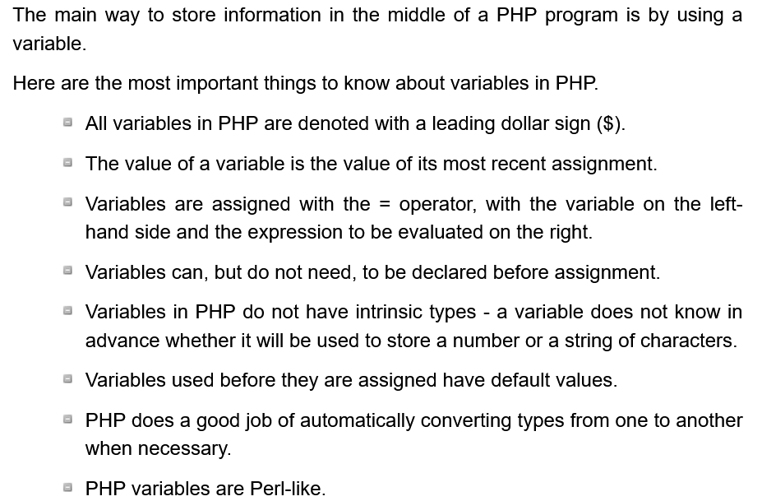
PHP Variables

Slide 66
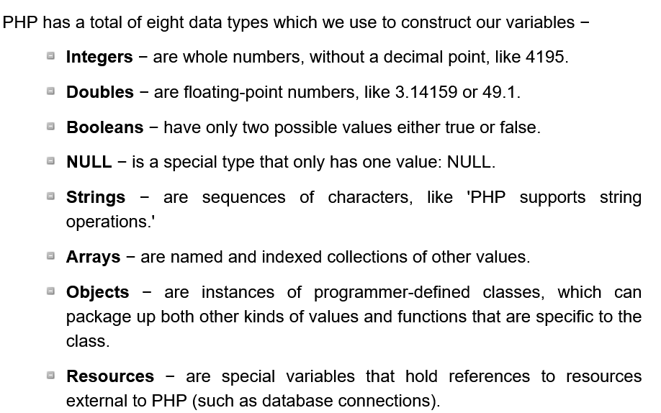
PHP Data Types

Slide 67
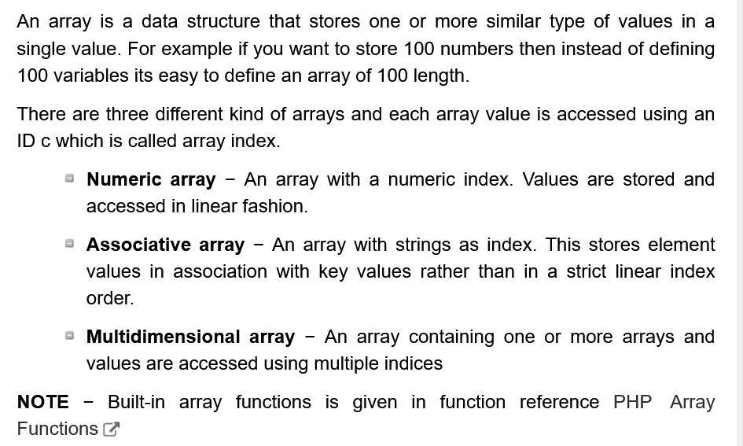
PHP Arrays

Slide 68
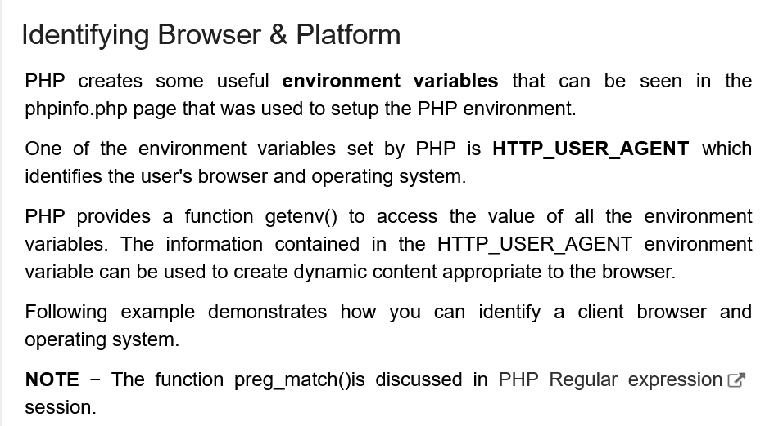

Slide 69
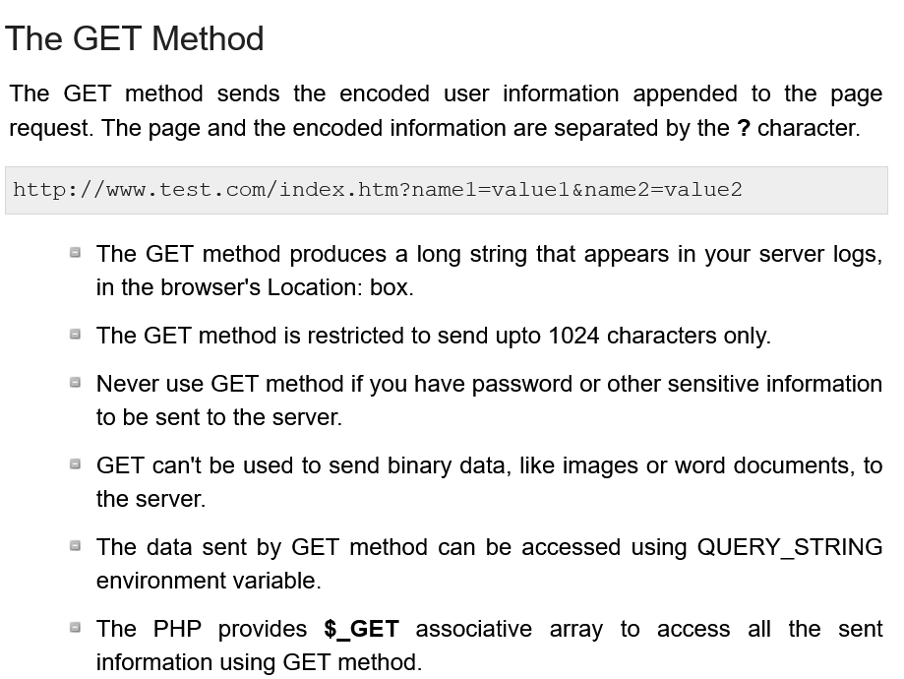

Slide 70
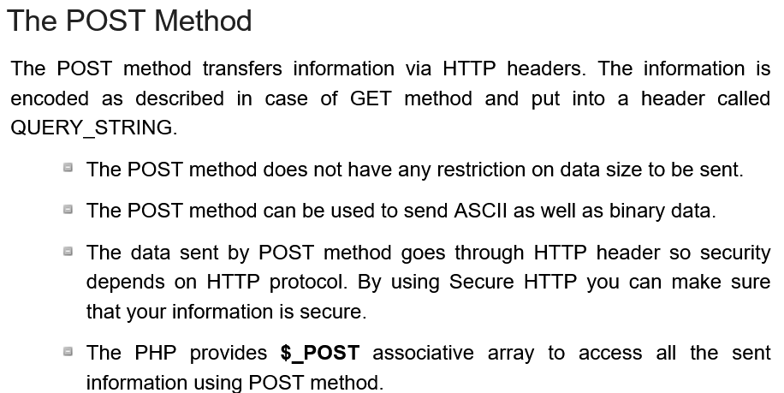

Slide 71
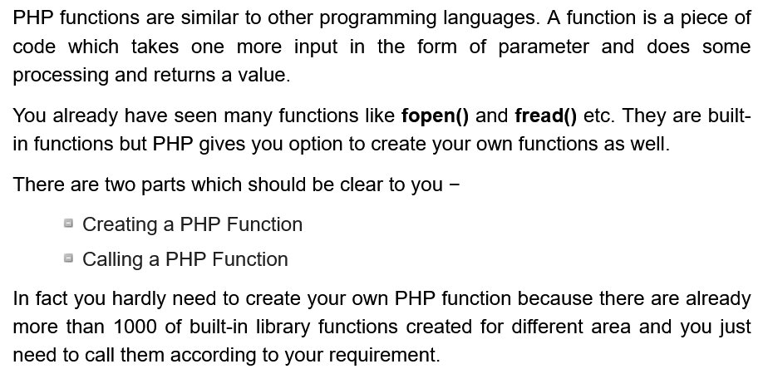
PHP Functions

Slide 72
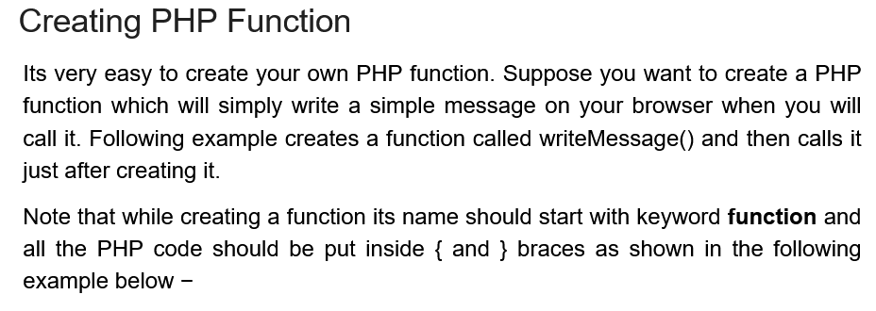

Slide 73
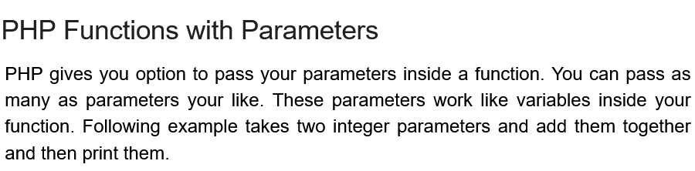

Slide 74
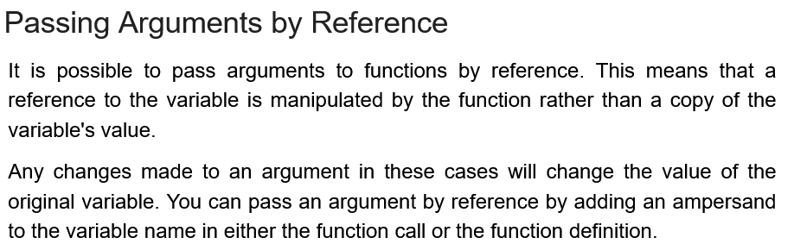

Slide 75
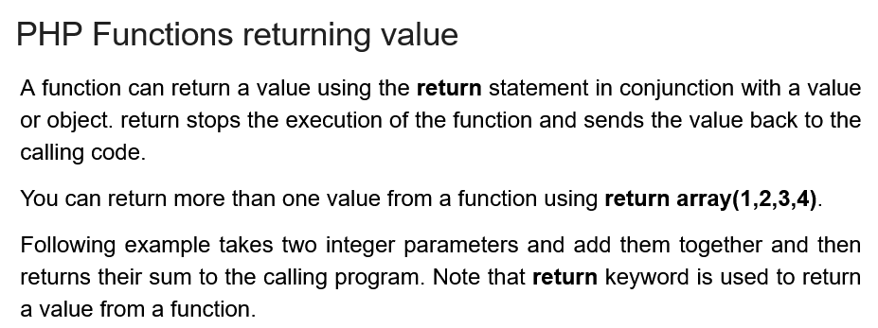

Slide 76
What is XAMPP?
XAMPP is one of the widely used cross-platform web servers, which helps developers to create and test their programs on a local web server.
It was developed by the Apache Friends, and its native source code can be revised or modified by the audience.
It consists of Apache HTTP Server, MariaDB, and interpreter for the different programming languages like PHP and Perl.
It is available in 11 languages and supported by different platforms such as the IA-32 package of Windows & x64 package of macOS and Linux.

Slide 77
What is XAMPP?
XAMPP is an abbreviation where X stands for Cross-Platform, A stands for Apache, M stands for MYSQL, and the Ps stand for PHP and Perl, respectively.
It is an open-source package of web solutions that includes Apache distribution for many servers and command-line executables along with modules such as Apache server, MariaDB, PHP, and Perl.
XAMPP helps a local host or server to test its website and clients via computers and laptops before releasing it to the main server.
It is a platform that furnishes a suitable environment to test and verify the working of projects based on Apache, Perl, MySQL database, and PHP through the system of the host itself.
Among these technologies, Perl is a programming language used for web development, PHP is a backend scripting language, and MariaDB is the most vividly used database developed by MySQL

Slide 78
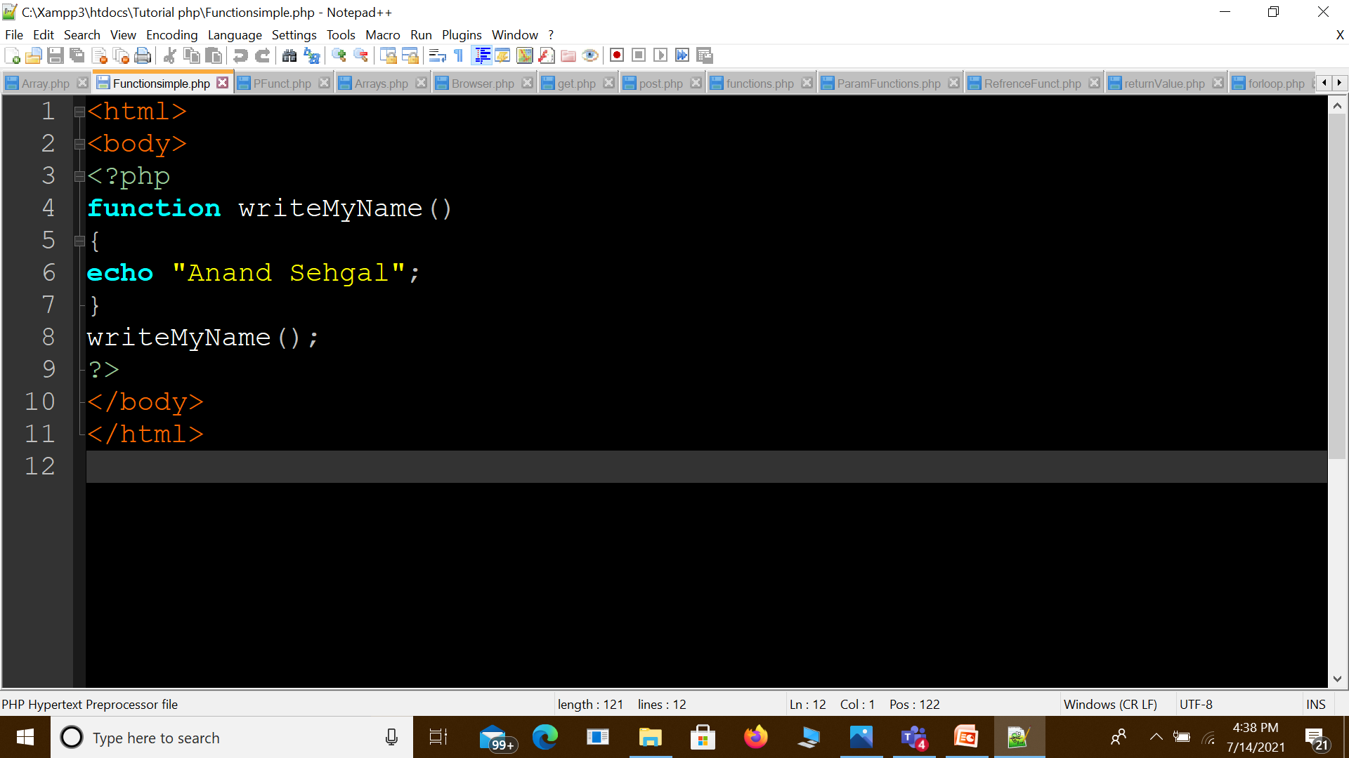

Slide 79


Slide 80
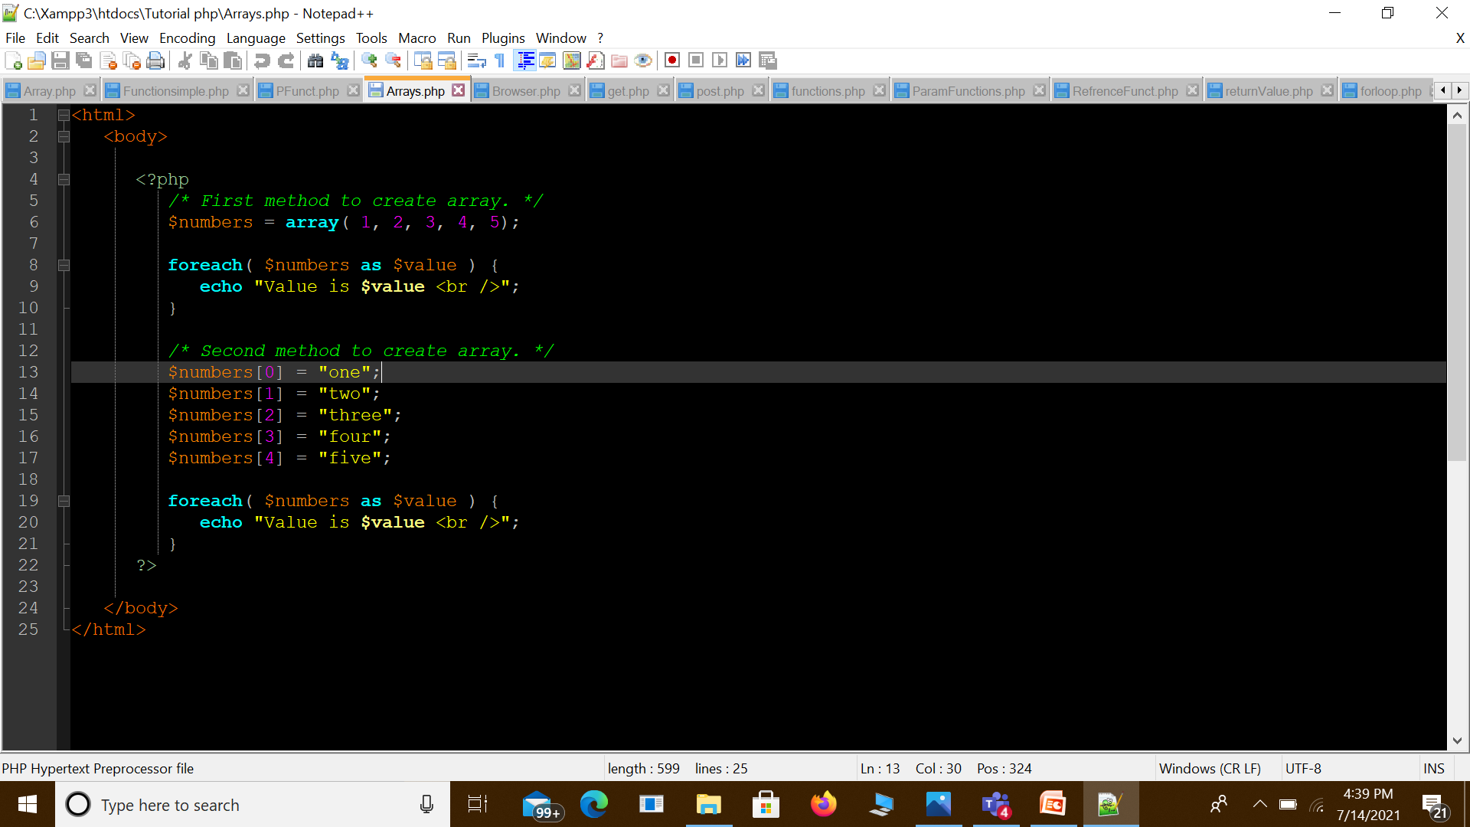

Slide 81
